Slide 1

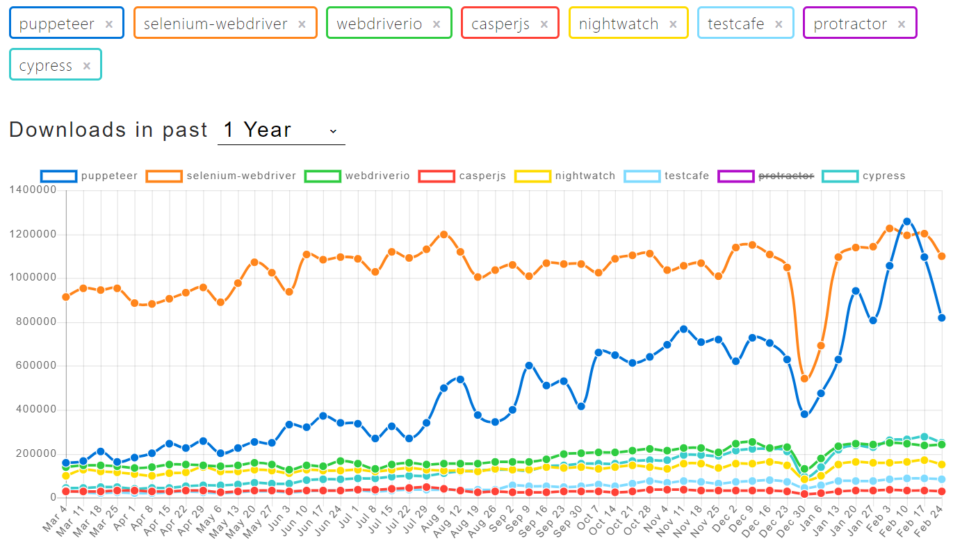

Slide 2
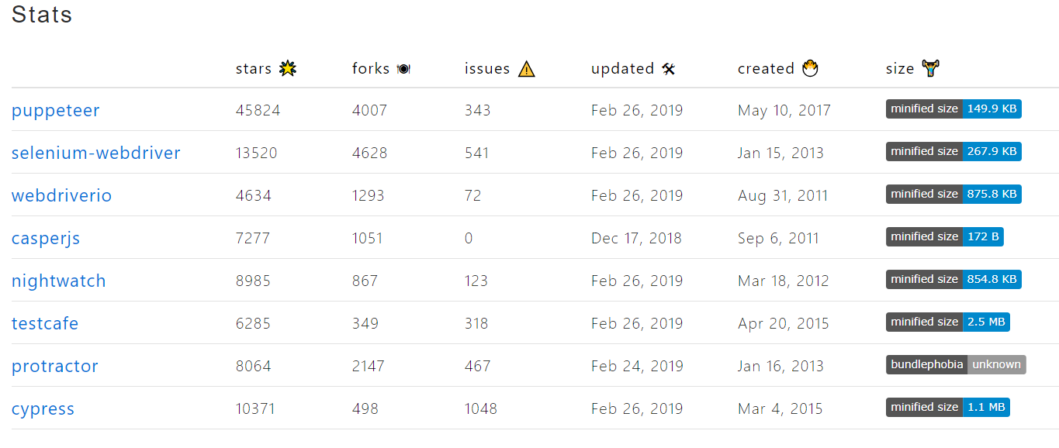

Slide 3

Web based engineering using Puppeteer
By
Dipjyoti metia

Slide 4

Topics to be discussed
Puppeteer
Pyramid of puppeteer
Why and how we choose puppeteer?
Code snippets and examples
Demo
Mocking
Code coverage
Client side performance testing
Logging
Git hooks & lint's
Where its sit in our CI pipeline ?
What else?
Q&A

Slide 5
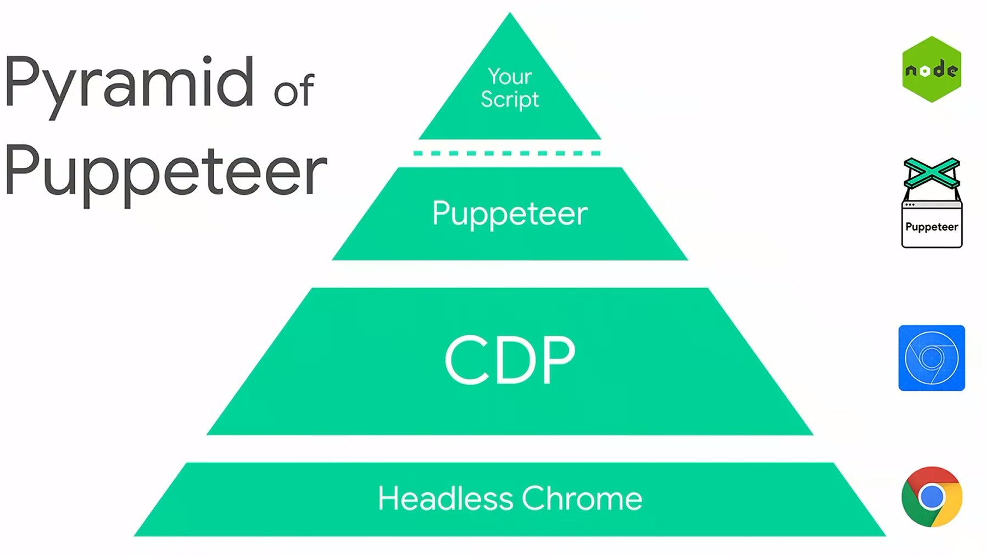

Slide 6
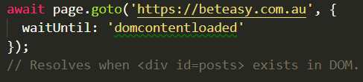
Test all modern features(ES6,CSS,HTML)
Async/await , heavy es6
Programmatic access to dev tools
Doesn’t wait for entire page to load, event specific
Cache pre-rendered results
Abort non-dom requests eg. Image,css,media by network interception which speedup the rendering process
Crawl a SPA

Slide 7
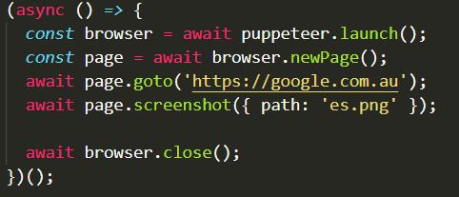
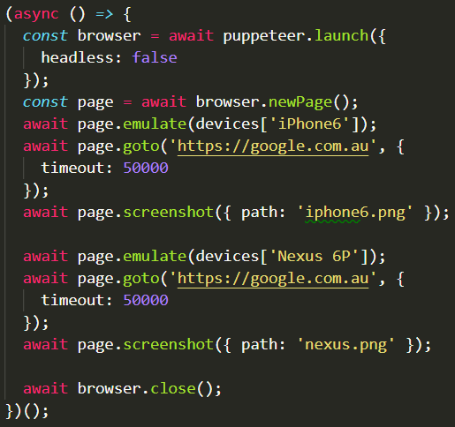
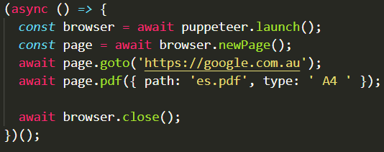
Taking Screenshots
Emulate device matrix and user agents
Generate pdf

Slide 8
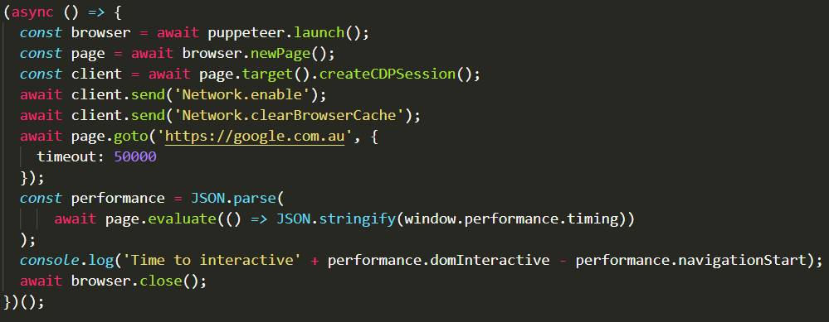
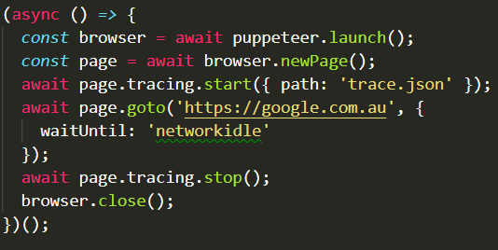
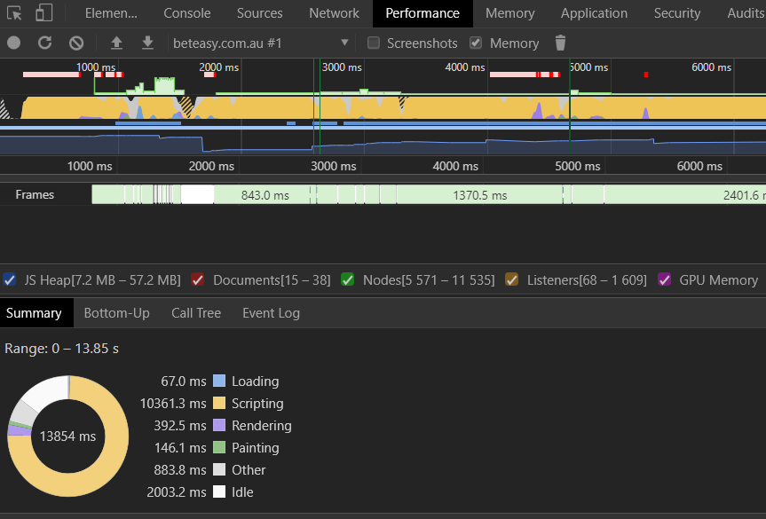
Capturing performance matrix
Create trace files

Slide 9

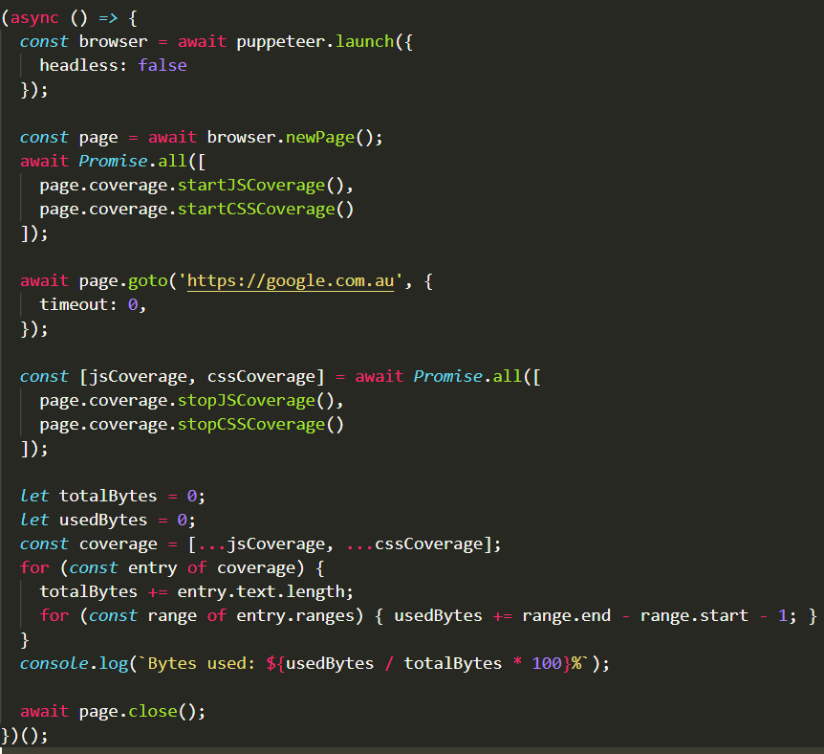


Code coverage

Slide 10
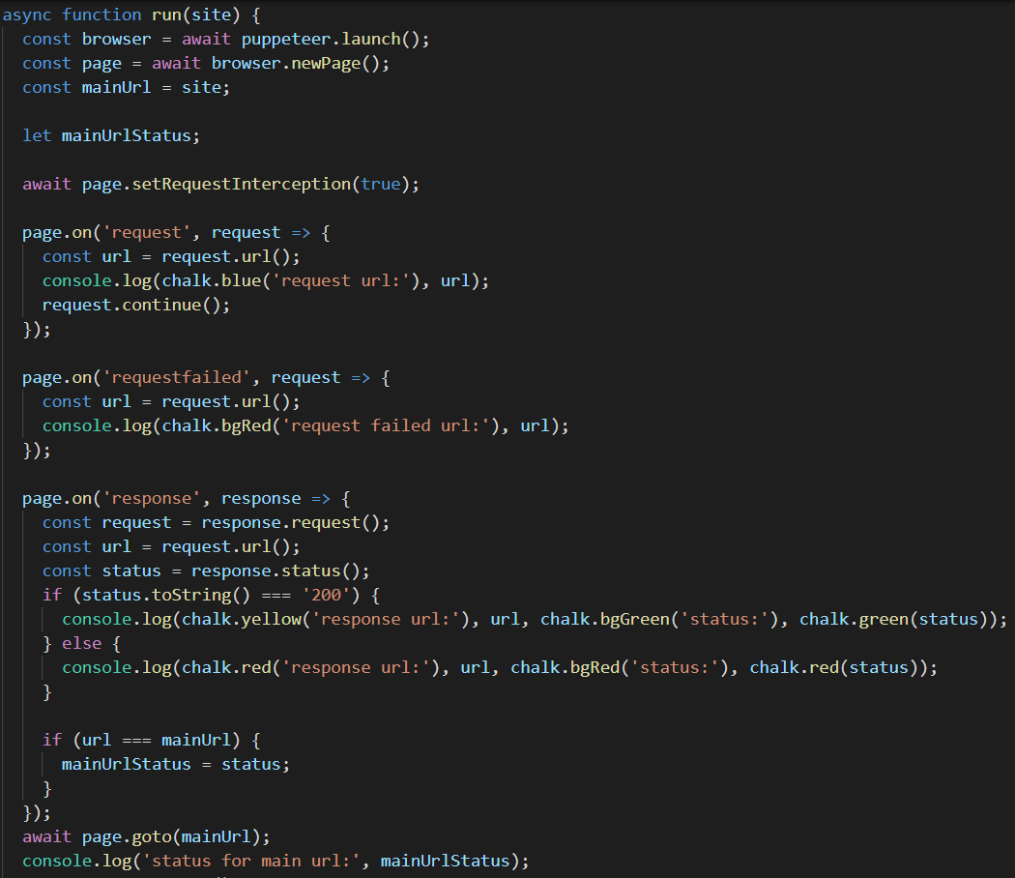
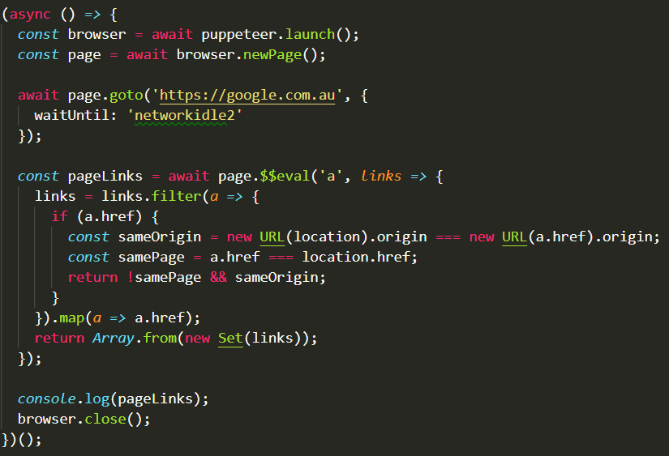
Page crawling

Slide 11
DEMO

Slide 12
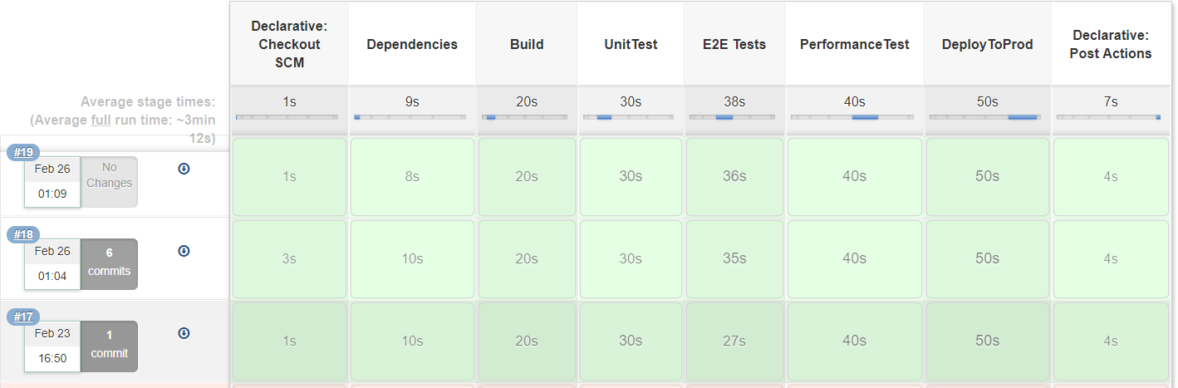
CI Pipeline

Slide 13
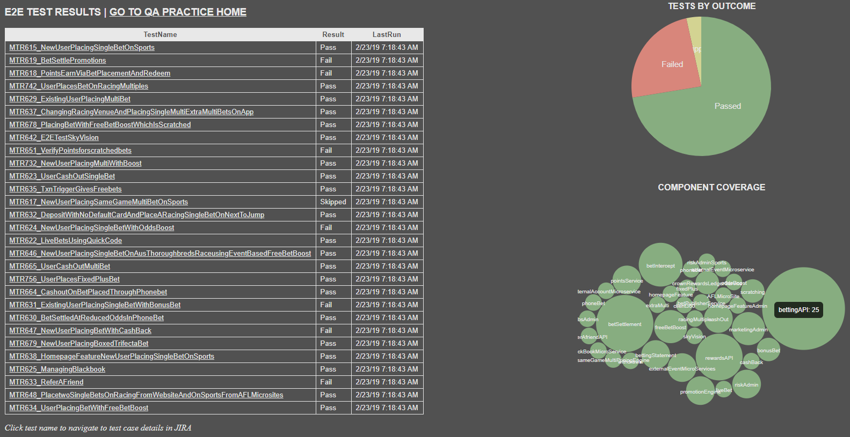

Slide 14
Reference
https://try-puppeteer.appspot.com/
https://github.com/GoogleChrome/puppeteer
https://developers.google.com/web/tools/puppeteer/
https://developers.google.com/web/tools/puppeteer/get-started
https://pptr.dev/
https://developers.google.com/web/tools/chrome-devtools/evaluate-performance/reference
https://developers.google.com/web/tools/chrome-devtools/javascript/

Slide 15
THANK YOU

Slide 16
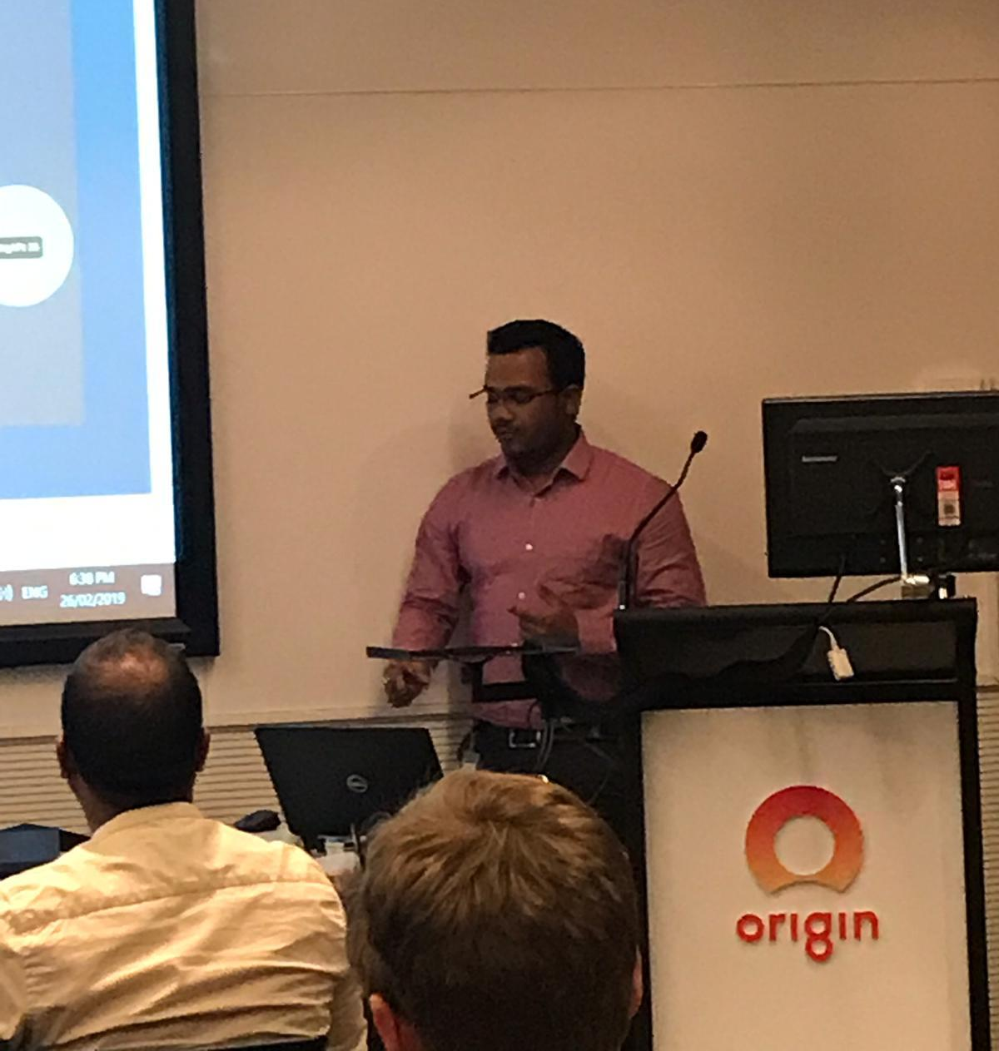
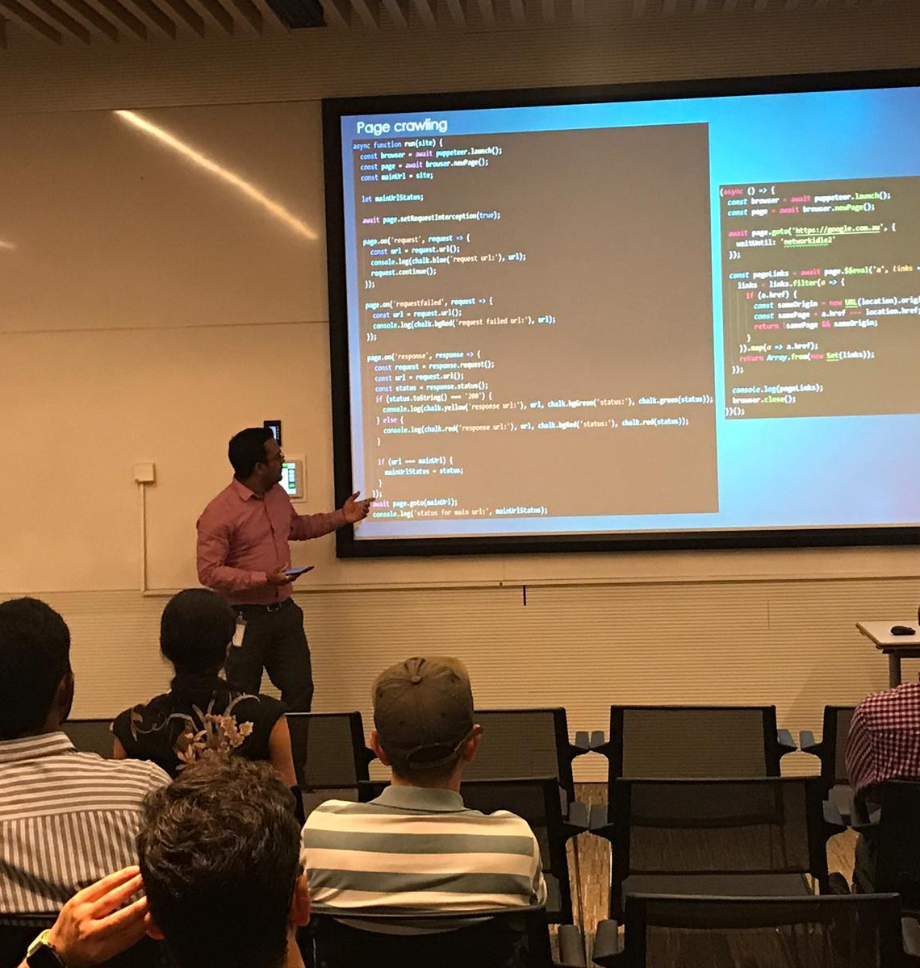
Few Pics from the session

